Slide 1
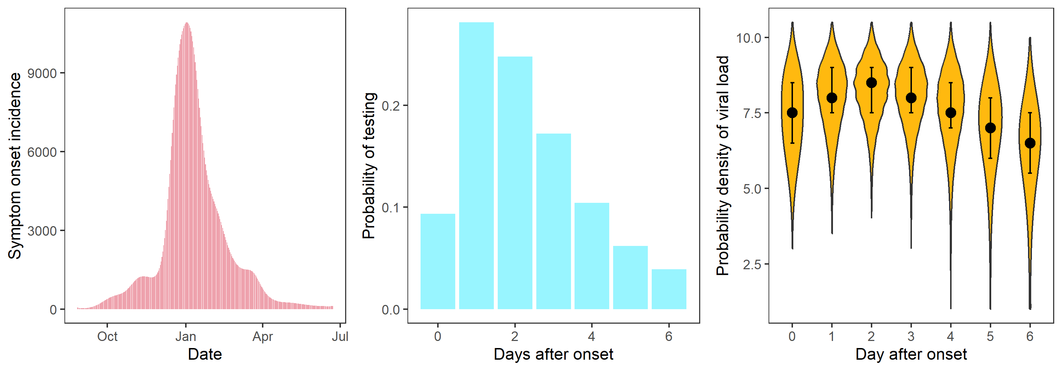
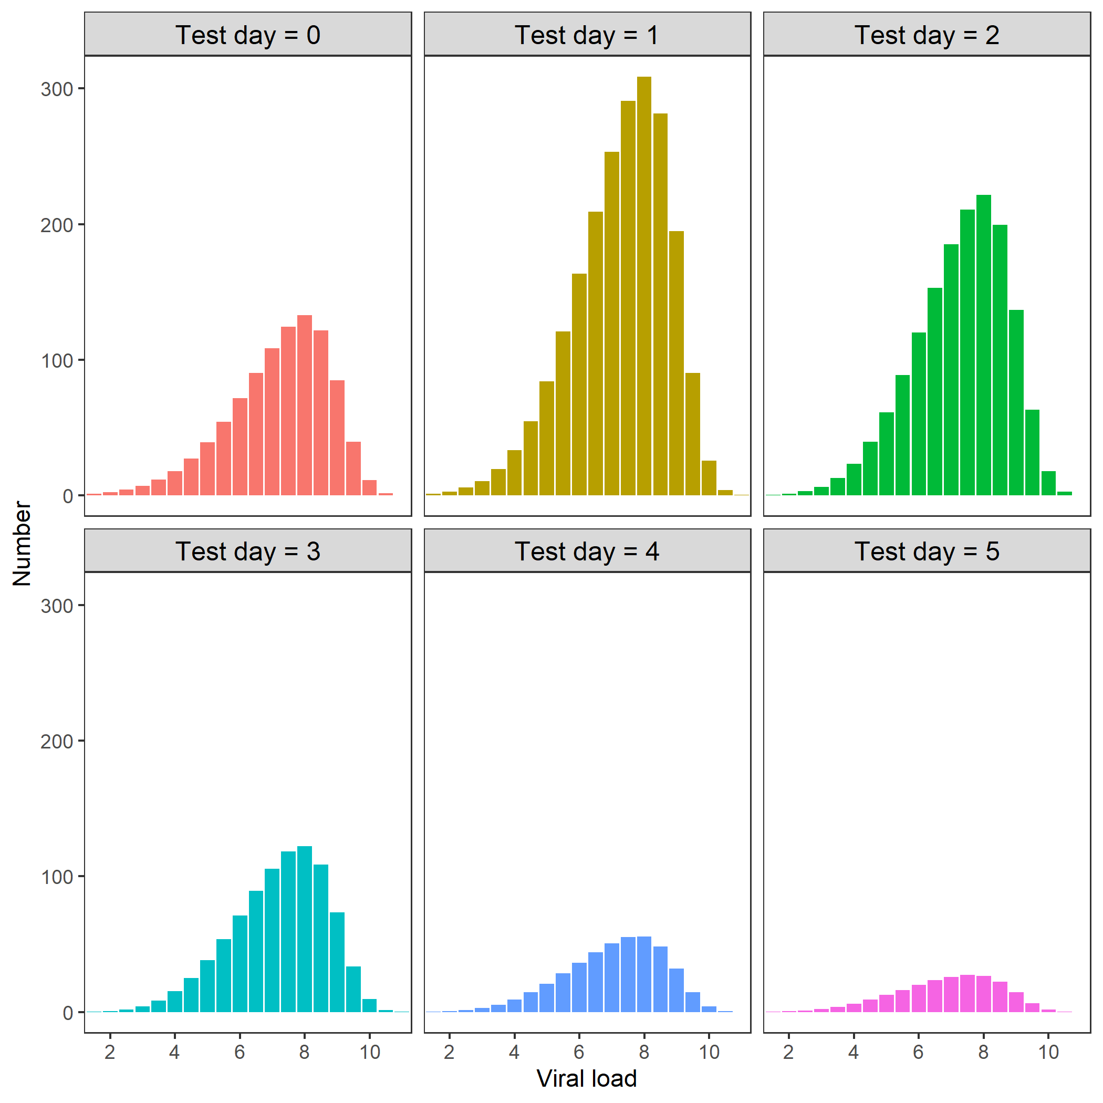
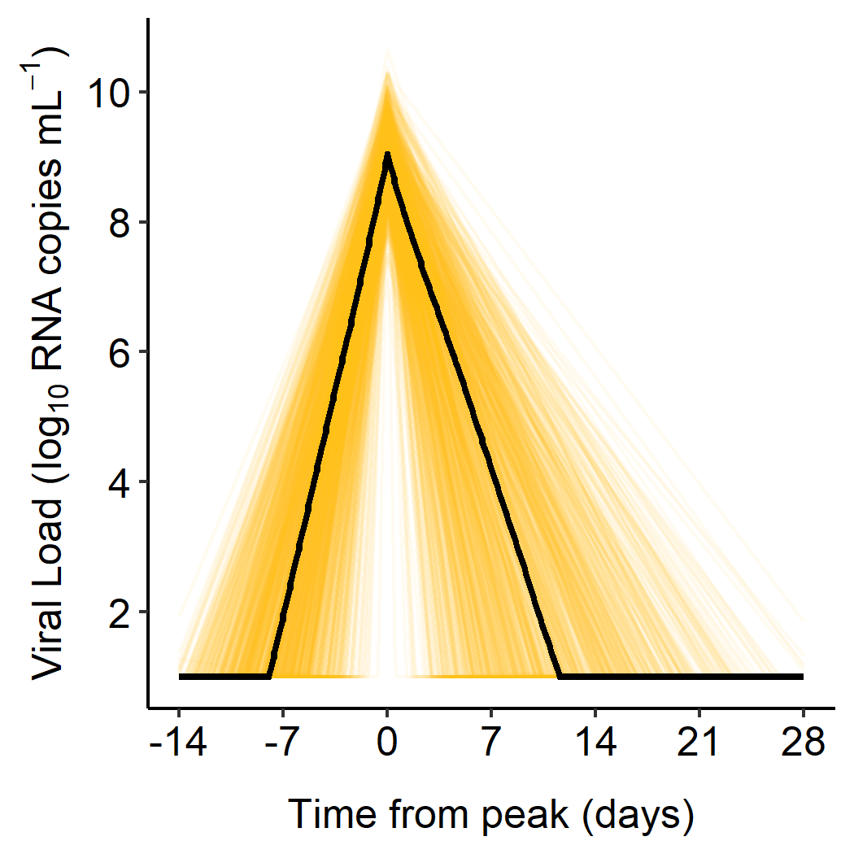
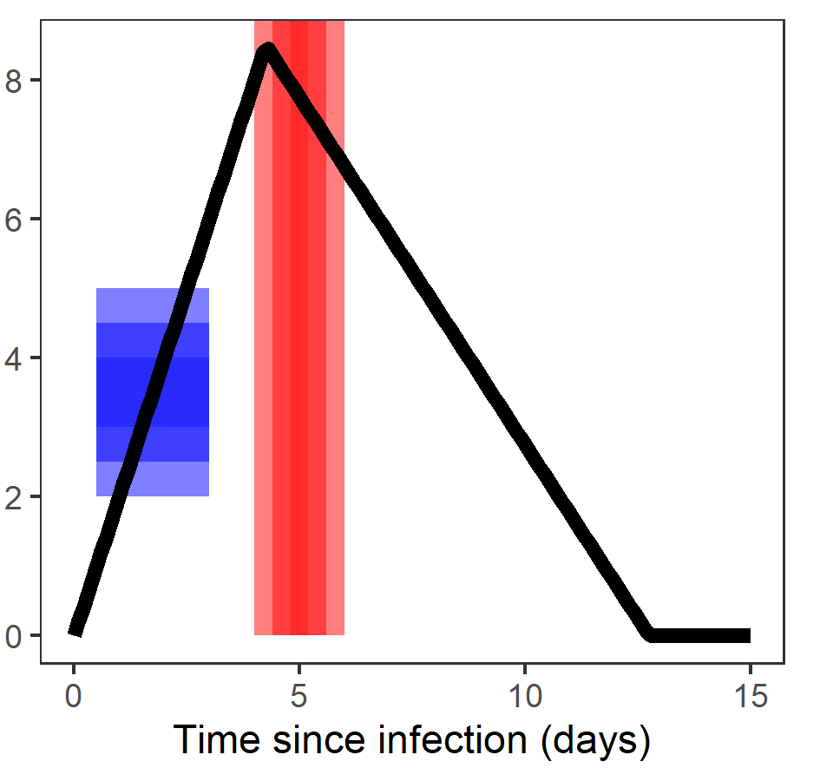
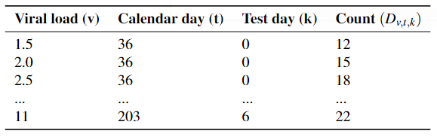

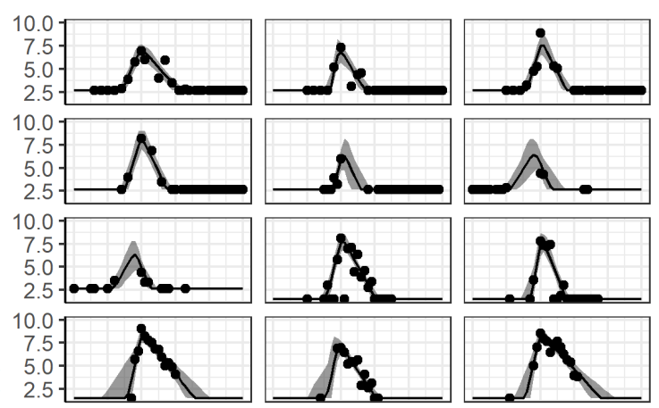
ϑ_{s}
ϑ_{test}
I(ϑ_{s})
4
δ_{k}^{test}(ϑ_{test} )
5
q_{v,k}(ϑ_{v,} ϑ_{symp})
6
6
6
3
3
Day j
N_{v,t,k}
1
2
ϑ_{v}
ϑ_{symp}
D_{v,t,k}
7
7
Likelihood
Prior P(ϑ)
8
8
POSTERIOR

Slide 2



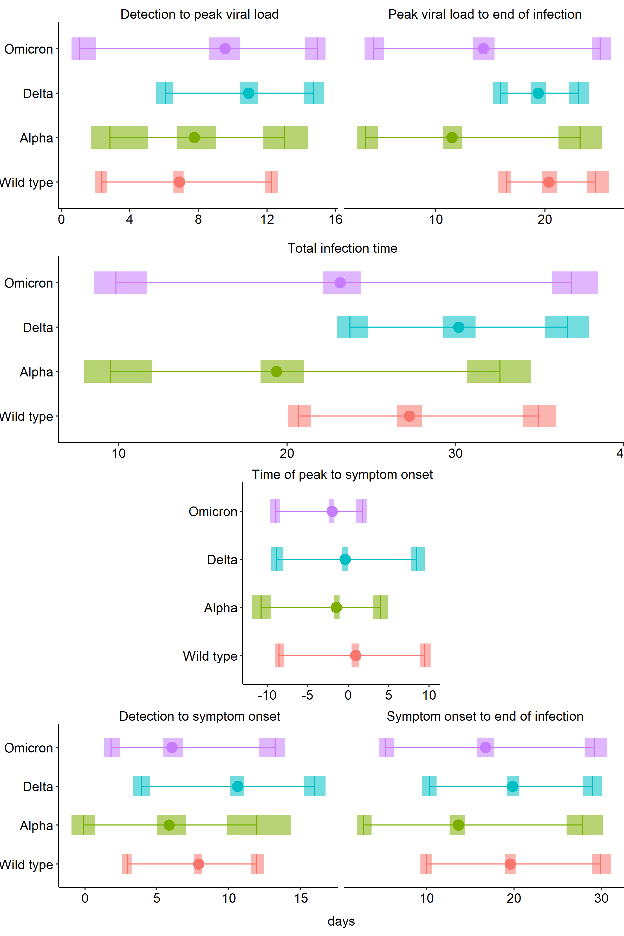
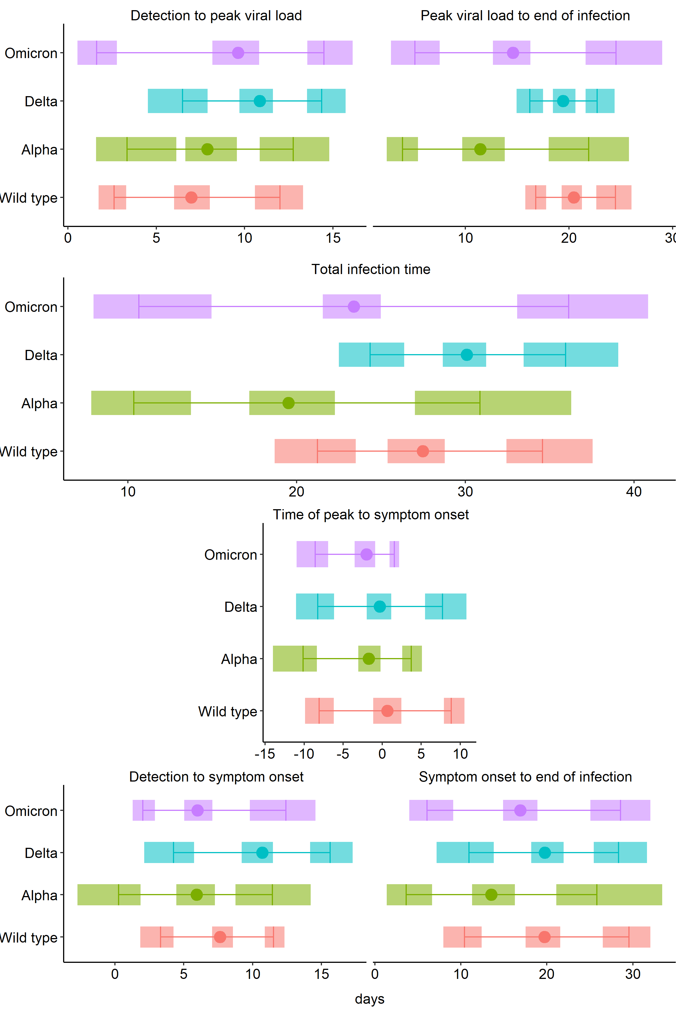

Detectable
Peak
Recovered
A
B
C
D
D
E
F
E
F
Detectable
Symptoms
Recovered

